Slide 1

Public Sentiment to the Federal Reserve’s Rate Cuts in 2024
Ben Belhassen Mohamed Ali, Ciampana Lorenzo, Filesi Gianluca, Tibi Gad

Slide 2

Research Questions
1
Public Sentiment
What is the overall public sentiment?
How do people feel about the rate cuts?
2
Online Discourse
How are people discussing this topic online?
What are their reactions?
3
Dominant Themes
Are there any dominant themes or concerns?
What are people worried about?

Slide 3

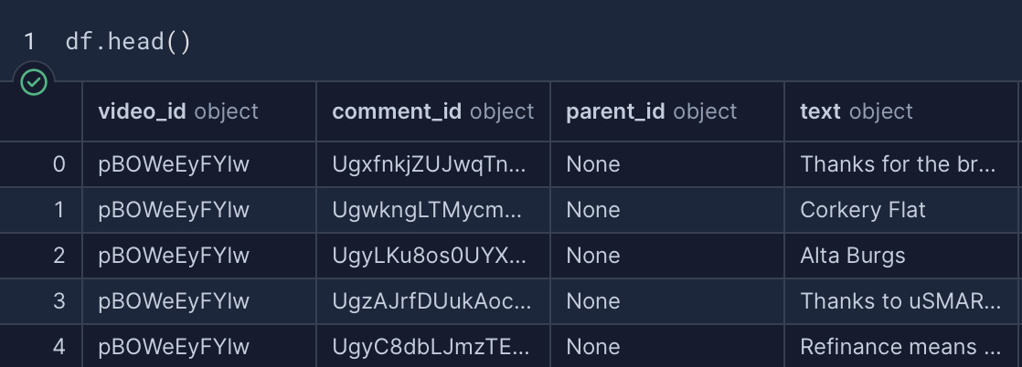
Data Overview
Data Sources
Why YouTube?
1) Federal reserve cuts interest rates by 0.5%, NBC news
2) How Fed Rate Cuts Affect The Global Economy, CNBC
3) Powell speaks after Fed lowers interest rates by half point, CNBC
Major platform where users actively discuss and react to financial news providing a rich, diverse, and dynamic public sentiment data.
Dataset Summary
1120 comments (and answers) collected.
Includes comment ID, and comment text.

Slide 4





Data Collection
YouTube Data API
Allow developers to access and interact with YouTube data
Python
Iteratively extracted comments from videos
Data storage
Merged extracted comments into a DataFrame

Slide 5


Data Preprocessing
Preprocessing cleans and structures text for better insights.
Noise Removal
POS Tagging
Lowercased text
Removed:
URLs
numbers
punctuation
special characters
single characters
Kept only meaningful words to enhance the quality of topic modeling and sentiment analysis by filtering out unnecessary parts of speech.
Lemmatization
Tokenization
Split text into individual words or phrases (tokens) to facilitate text processing and analysis.
Reduced words to their base form, using linguistic rules

Slide 6

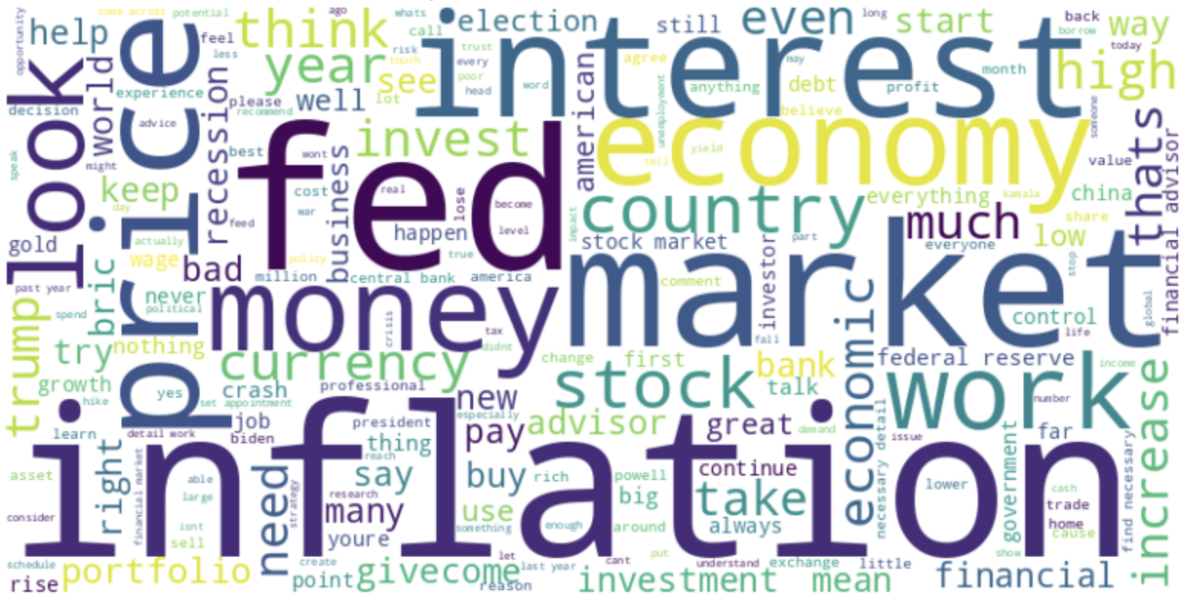
Word Cloud

Slide 7
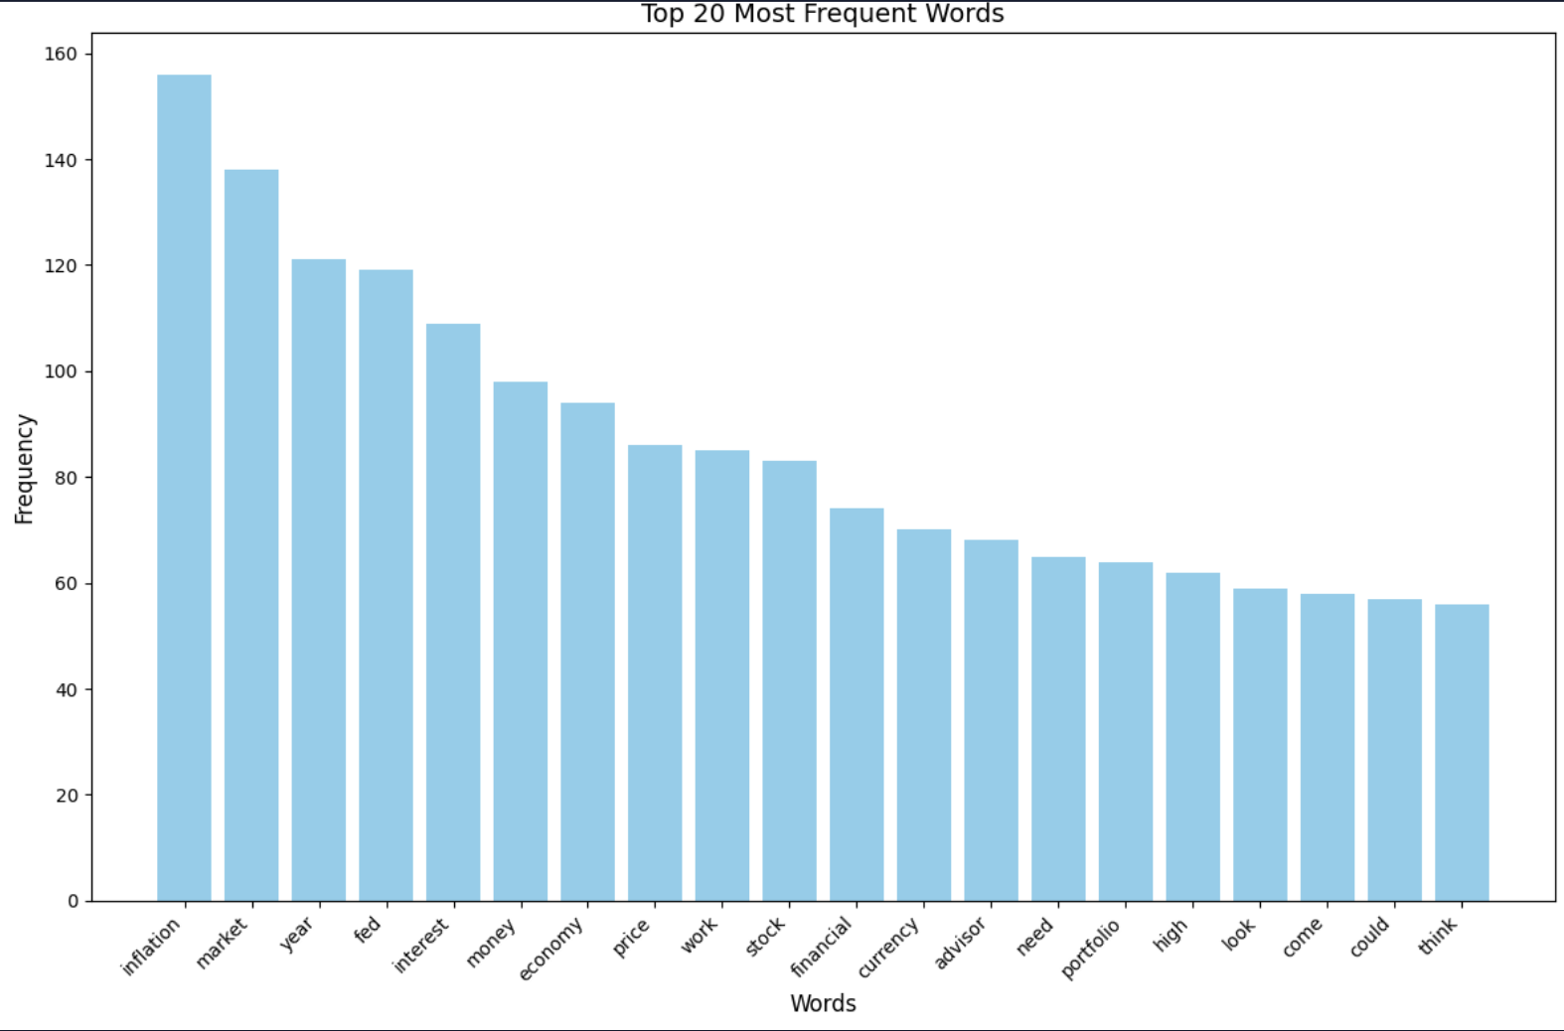
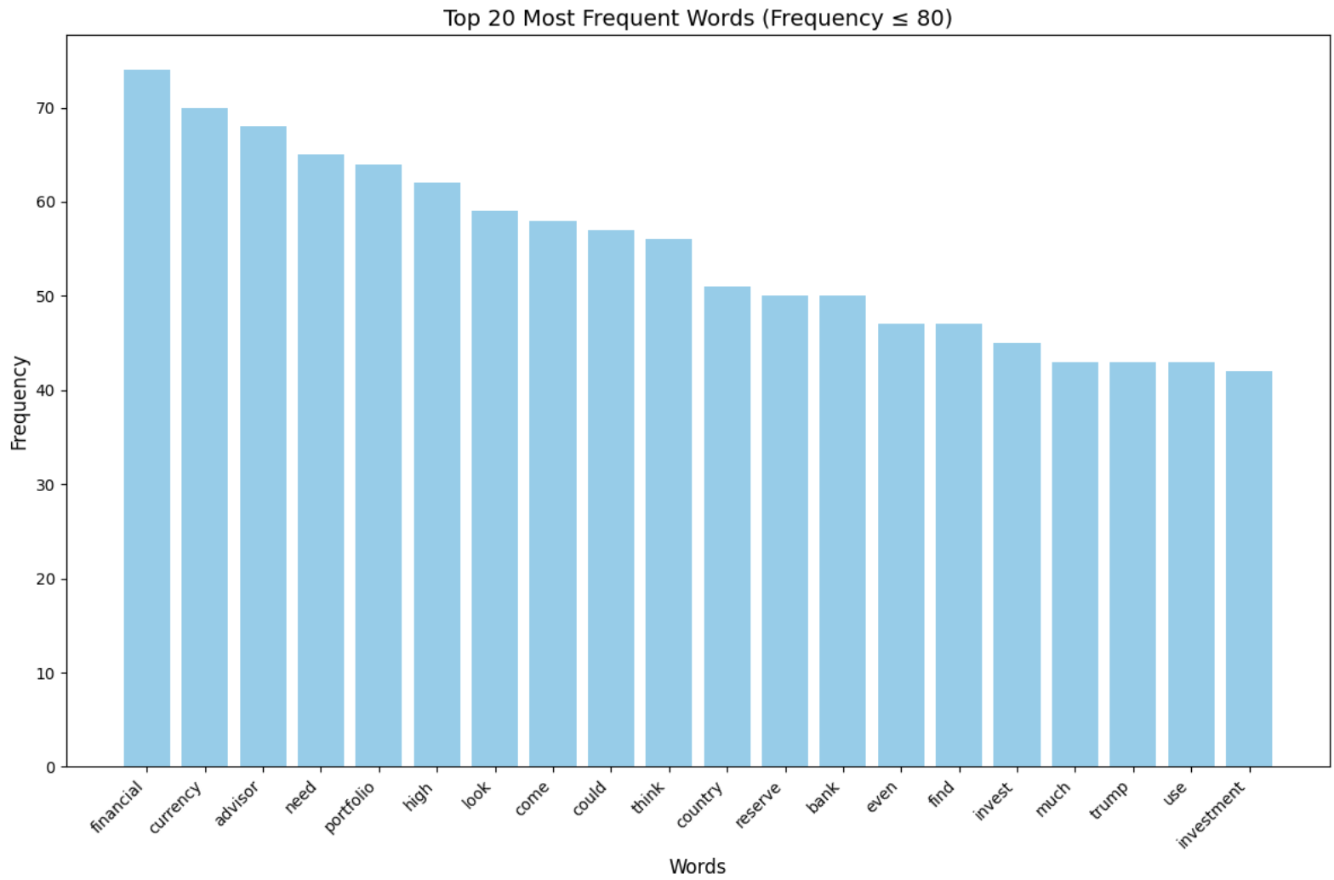
Word Frequency
Identified the top 20 most frequent words, highlighting the dominant themes in the discussion.
Words that are too core for the topic have been restricted to have a more detailed view.

Slide 8
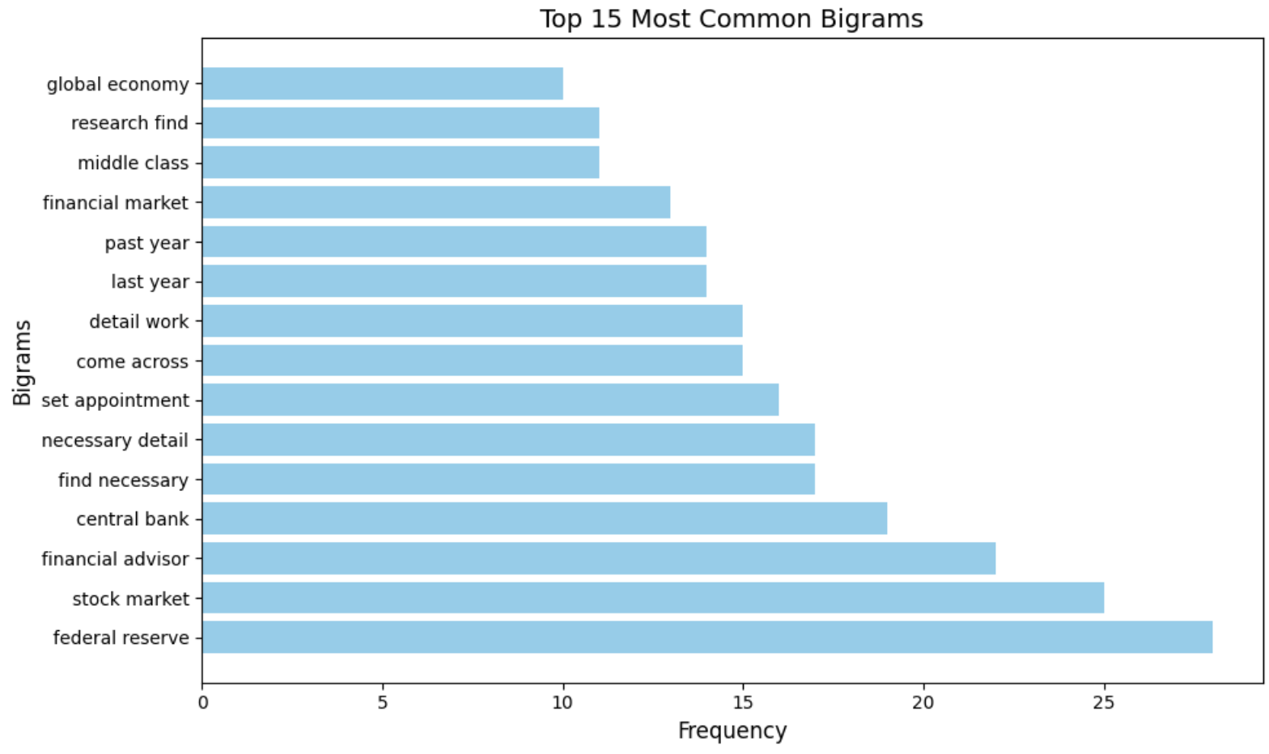
Bigrams Analysis
Examines pairs of consecutive words in a text to identify common word associations,
patterns, and contextual relationships.
In simpler terms...
pairs of frequently occurring words.
Main focuses:
economic policy
financial impact.

Slide 9
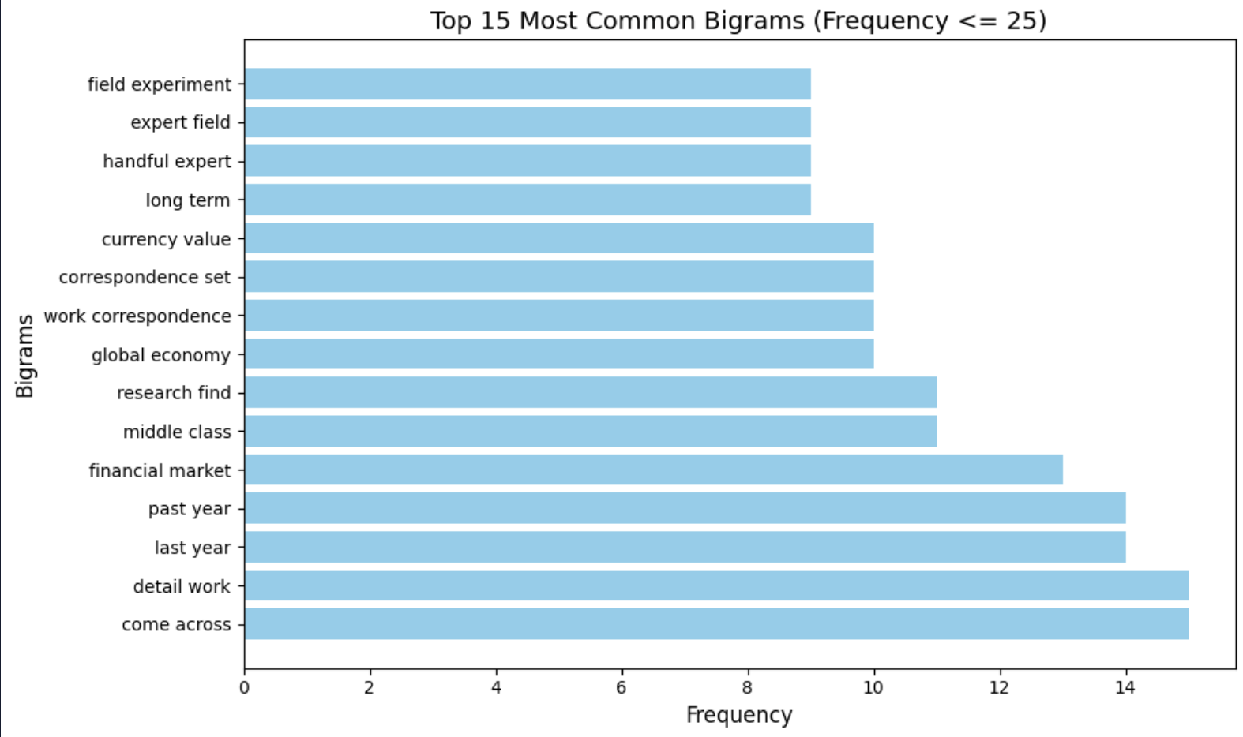
Ensure more relevant word
associations and insights.

Slide 10


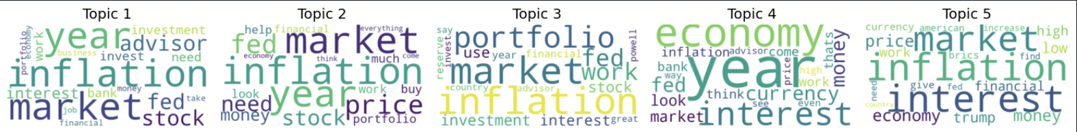
Topic Modeling
Coherence Score
Latent Dirichlet Allocation (LDA) Model
Optimized the number of topics based on coherence
5 hidden themes through probabilistic inference

Slide 11



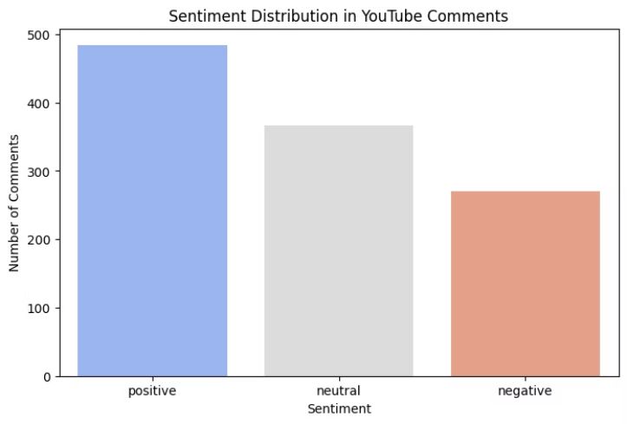
Sentiment Analysis
Sentiment Scores
Characteristics
Positive, Neutral, Negative ratings.
VADER Model
Optimized for short text/social media.
Specifically designed for informal social media texts

Slide 12
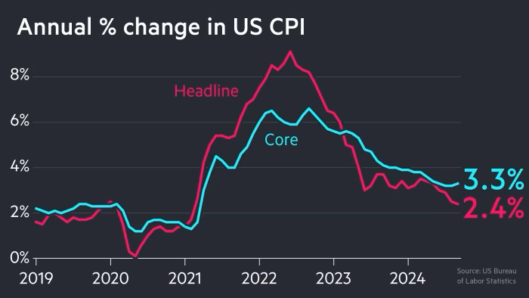


Results and Interpretations
Key Topics: Discussions frequently revolved around inflation, market conditions, and financial impacts
Sentiment Analysis:
Positive: 43,2% users see rate cuts as a financial opportunity
Neutral Discussions: Analytical and fact-based comments focus on economic implications
Negative Views: Some users express frustration about timing or potential long-term consequences.
Topic modeling: Users discuss personal finance (investments, stock market trends, and financial planning).

Slide 13
Conclusion based on results
1
Answering the Research Question
Public sentiment is positive regarding the Fed’s rate cut decision, and infere about potential investments.
2
Main Concerns
Concerns revolve around inflation, financial markets, and economic stability.
3
Sentiment Analysis
Quantifiable evidence of public perception was obtained from the sentiment analysis.

Slide 14


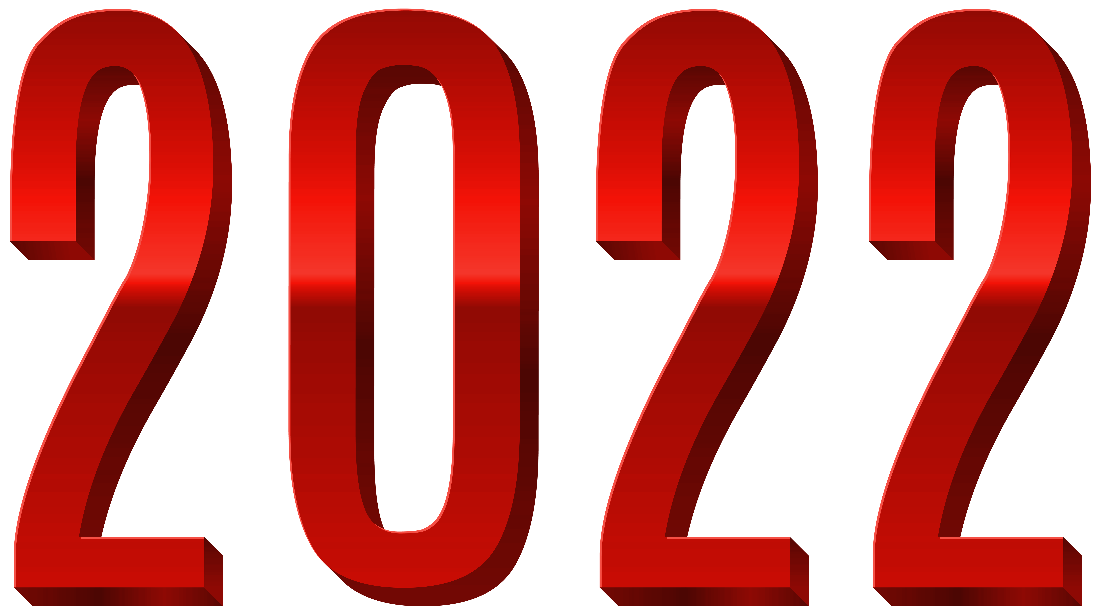

Slide 15
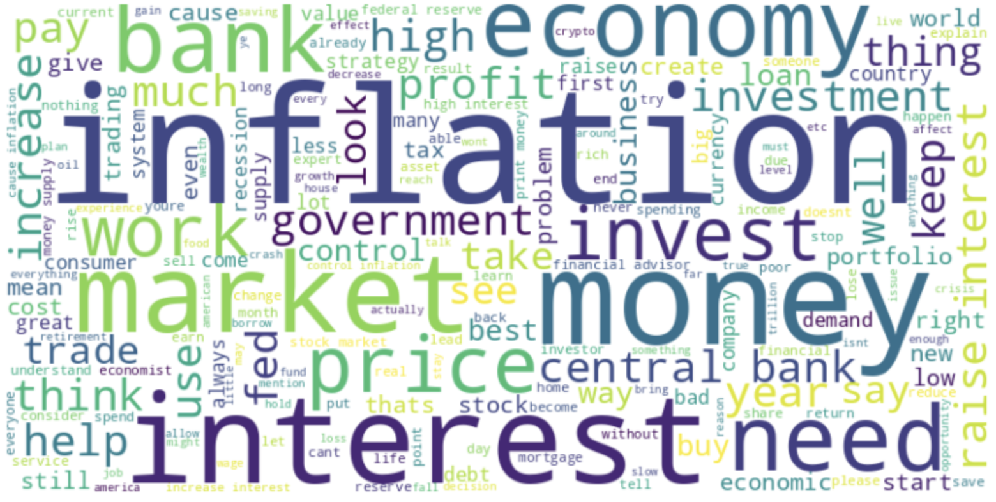
Word Cloud

Slide 16
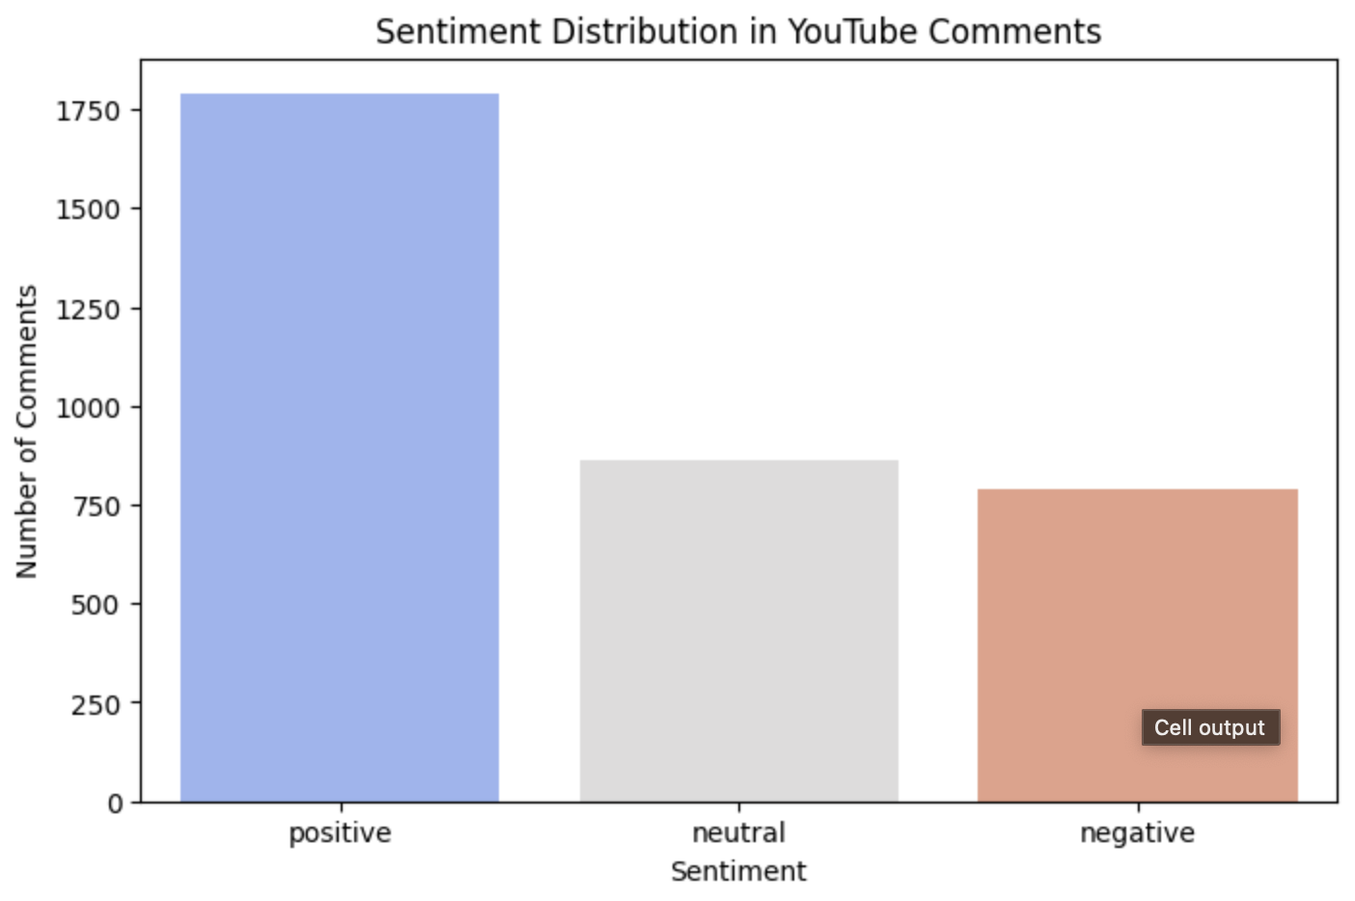
Sentiment Analysis

Slide 17


